Slide 1

IT Essentials (CompTIA A+) Ch. 11
Essential Peripherals
Chapter 11
Notes:
1

Slide 2
Overview
In this chapter, you will learn how to:
Explain how to support multipurpose connectors
Identify and install standard peripherals on a computer
Identify and install standard storage devices (that aren’t SSDs or HDDs) and their media
Notes:
2
Instructor Tip
When gaining attention and establishing common ground, ask questions of the class such as, “Who here has ever installed a peripheral?”
For a positive statement, tell the class, “In this lesson, we are going to learn about various peripheral drives, how they work, and how to recognize and install them.”

Slide 3
Supporting Common Ports
Dealing with a device that isn’t playing nicely involves:
The device
The port to which it is connected

Slide 4
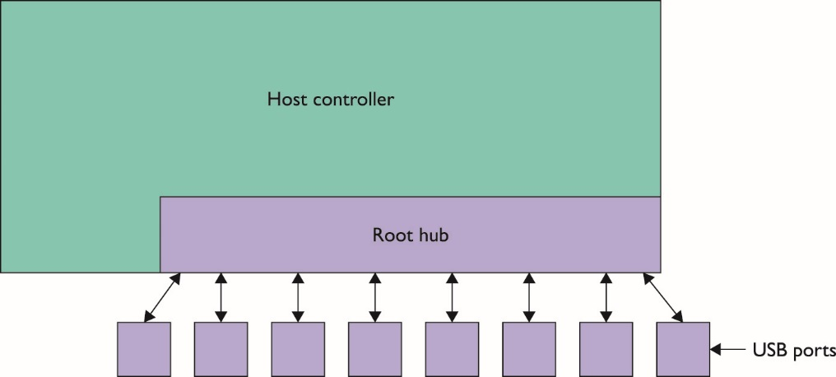
USB Ports
Understanding USB
USB host controller – circuit built into the chipset
Controls every USB device connected to it
USB root hub
Physical connection to USB ports
Figure 11.1 Host controller, root hub, and USB ports

Slide 5
USB Ports
USB standards and compatibility
USB 1.1 had two speeds: Low-Speed USB (1.5Mbps) and Full-Speed USB (up to 12Mbps).
USB 2.0 introduced Hi-Speed USB (480Mbps).
USB 3.0 has speeds up to 5Gbps (SuperSpeed USB).
USB 3.1 can handle up to 10Gpbs (SuperSpeed USB 10Gbps).
USB 3.0 and 3.1 use different and clearly marked ports.
Notes:
For the 220-901 exam, focus on USB 1.1, 2.0, and 3.0.

Slide 6
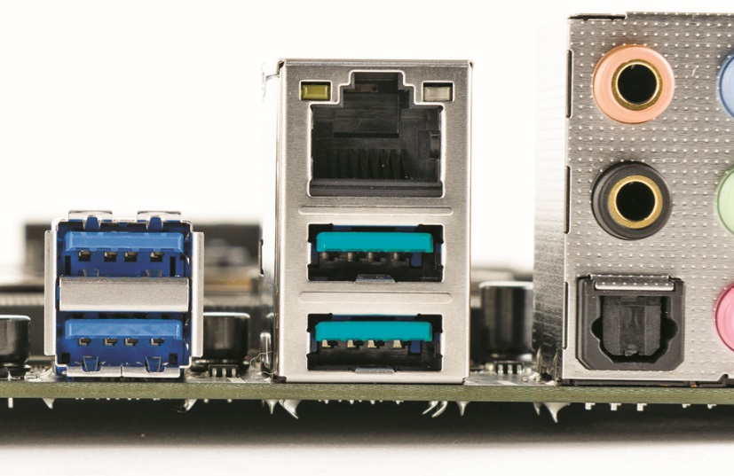
USB Ports
Figure 11.4 Blue USB 3.0 ports (left) and teal USB 3.1 ports (center)

Slide 7
USB Ports
USB cables and connectors
Multiple sizes: A, B, mini-A, mini-B, micro-A, micro-B, and Type C
SuperSpeed: a USB 3.0/3.1 cable required
USB hub
Extends a single USB connection to two or more USB ports
Notes:
On USB 1.1 and 2.0 cables, the A and B ports and connector use four pins, while the rest use five pins. USB 3.0/3.1 A and B ports and connectors use nine pins.
In general, your USB connection will operate at the speed of the slowest device involved.

Slide 8
USB Ports
USB configuration
Install device driver before you plug your device into the USB port.
Windows and Mac OS X come with a large number of built-in drivers.
A mismatch between available and required power for USB devices can result in nonfunctioning or malfunctioning USB devices.
If pulling too much power, remove devices until the error goes away.

Slide 9
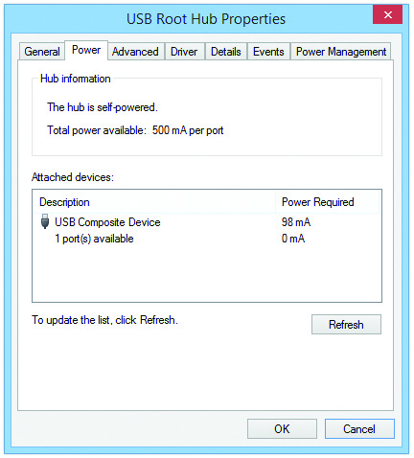
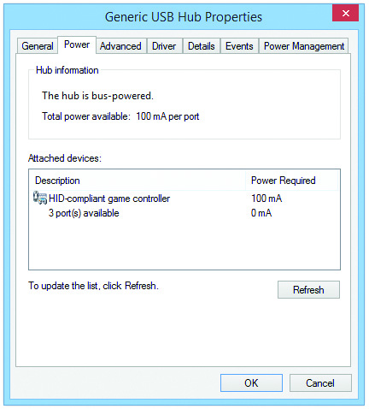
USB Ports
Figure 11.9 USB hub Power tab
Figure 11.10 General-purpose bus-powered hub

Slide 10
FireWire Ports
FireWire (also known as IEEE 1394)
Much like USB but uses different connectors and is the older technology
Understanding FireWire
Two distinct connectors
6-pin powered connector
4-pin bus-powered connector
Two speeds
IEEE 1394a runs at 400Mbps
IEEE 1394b runs at 800Mbps
FireWire devices may be daisy-chained

Slide 11
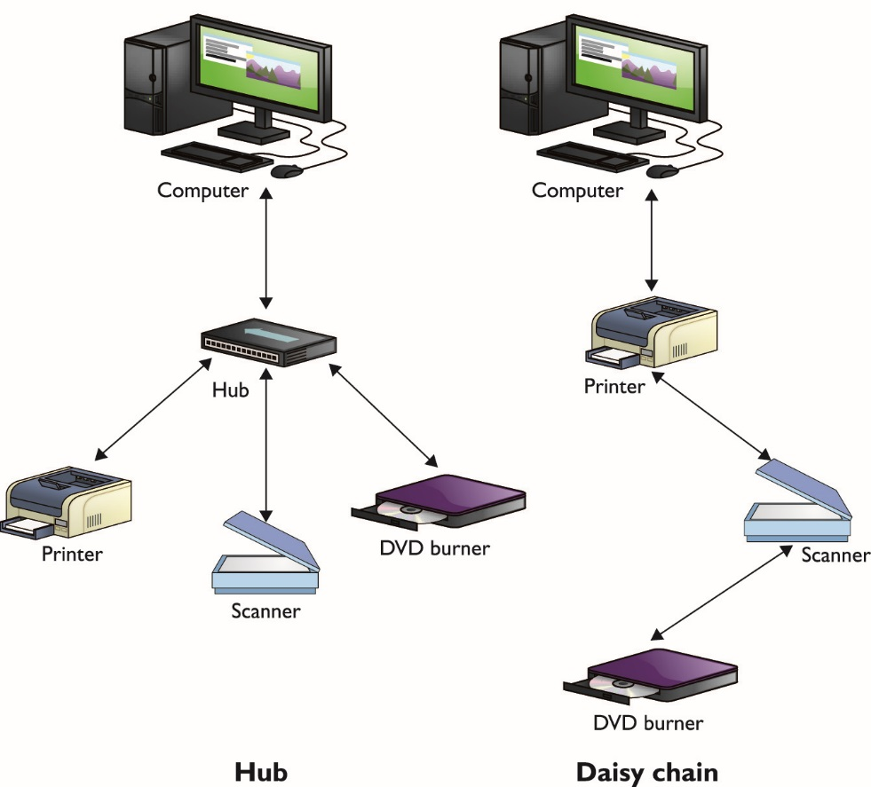
FireWire Ports
Figure 11.12 Hubbed versus daisy-chained connections

Slide 12
FireWire Ports
Configuring FireWire
Install driver before connecting device.
Pre-installed Windows drivers almost always work perfectly.
FireWire devices use more power than USB devices.

Slide 13
Thunderbolt Ports
Thunderbolt ports are a high-speed alternative to existing technologies.
Tap into the PCI Express bus for up to 6 external peripherals
Provide amazing bandwidth
Thunderbolt 1 runs full duplex at 10Gbps.
Thunderbolt 2 aggregates internal data channels, enabling throughput at up to 20Gpbs.
Thunderbolt 3 offers throughput at up to 40Gbps.
Notes:
Know the characteristics and purposes of USB, FireWire, and Thunderbolt connection interfaces for the exams.

Slide 14
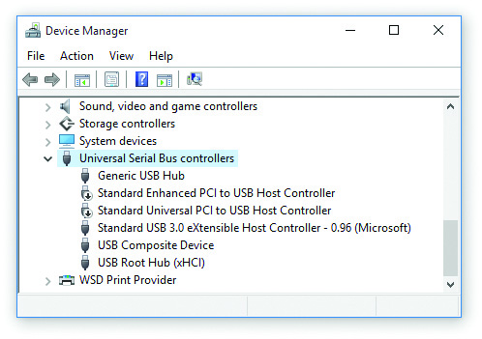
General Port Issues
Troubleshooting
Make sure port is turned on.
Use Windows Device Manager.
Figure 11.13 Disabled USB controller in Device Manager in Windows 10

Slide 15
Common Peripherals
Keyboards
The keyboard is the primary way to input data into a PC.
Modern operating systems come with drivers.
Windows-specific vs. Mac OS-specific keyboards have different modifier keys.
Pointing devices
Mouse
Touchpad
Optical mouse
Notes:
Tech Tip
Wireless keyboards are a wonderful convenience because they remove the cable between you and the PC, but make sure you keep a complete set of spare batteries around.

Slide 16
Common Peripherals
Biometric devices
Scan and remember unique aspects of various body parts
Uses information as a key to restrict access
Smart card readers
Scan an embedded chip in certain devices such as ID badges to enhance security
Bar code readers
Read standard Universal Product Code (UPC) bar codes primarily to track inventory

Slide 17
Common Peripherals
Touch screens
Monitor with sensing device to detect contact
Motion sensors
Respond to external movement to update some function of the computing device
KVM switches
Keyboard, video, mouse (KVM) switch most commonly allows computers to be viewed and controlled by a single mouse, keyboard, and screen.

Slide 18
Common Peripherals
Gamepads and Joysticks
Joysticks are used for advanced flight simulation.
Gamepads look like standard video game controllers.
Digitizers
Pen tablet enables users to paint, ink, pencil, or otherwise draw on a computer.

Slide 19
Multimedia Devices
Digital cameras and camcorders
Electrically simulate older film and tape technology
Storage media – digital film
Removable storage media such as Secure Digital (SD) card
Connection
USB or card reader
Quality expressed as megapixels
Form factor
Range: tiny, ultra-compact models to monster cameras
Notes:
While digital cameras and digital camcorders can be considered distinct products, their features have become nearly identical. Both take pictures. Both take videos. In fact, a lot of high-end digital cameras take better video than digital camcorders.

Slide 20
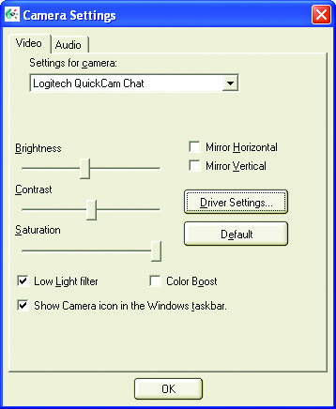
Multimedia Devices
Web cameras (or Webcams)
Commonly used for Internet video communication
Figure 11.36 Camera Settings applet

Slide 21
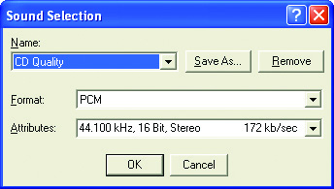
Sound Cards
Sound is recorded through sampling.
Bit depth is the number of characteristics captured during sampling.
Sound can be captured as stereo (two tracks) or monaural (one track).
CD quality sound recorded at 44.1 KHz with 16-bit depth in stereo.
Figure 11.37 Sound Recorder settings

Slide 22
Sound Cards
Recorded sound formats
WAV – common in the PC world
Compressor/decompressor programs (codecs)
MP3 – Fraunhoffer MPEG-1 Layer 3 codec
Compressing WAV files to MP3 format
Shrink WAV files by a factor of 12 without losing much sound quality
CD quality MP3 bit rate: 128 Kbps

Slide 23
Sound Cards
MIDI
Second processor on the sound card interprets standardized musical instrument digital interface (MIDI) files.
Playing sounds
Standard programs on each OS
Streaming media – via the Internet, not stored on the computer

Slide 24
Sound Cards
Sound card standards
ACʹ97
Intel High Definition Audio (HDA)
Speaker support
Every sound card supports two speakers or a pair of headphones.
Better sound cards support five or more discrete speaker channels.

Slide 25
Sound Cards
Jacks
Main speaker out – connects standard speaker
Line out – connect to external device
Line in – allows import from external device
Rear out – rear speakers for surround sound
Analog/digital out – special connection to digital speaker systems or subwoofer
Microphone – voice input
Joystick – now obsolete

Slide 26
Speakers
Stereo – classic speaker technology
2.1 speaker system
Pair of standard stereo speakers
5.1 speaker system
Five channels for surround sound
Sony/Philips Digital Interface (S/PDIF) connector
Enables connection from sound card directly to a 5.1 speaker system or receiver

Slide 27
Sound Cards
Microphones
Connection to the sound card for recording input audio
Headset includes a built-in microphone
MIDI-enabled devices
Digital audio workstation software allows input of MIDI information.

Slide 28
Video Capture
Hardware
Connectors for your device
Decent computer with lots of free hard drive space and substantial RAM
Software
Video-editing applications for importing and working with video directly
Two or more separate tracks – picture and audio

Slide 29
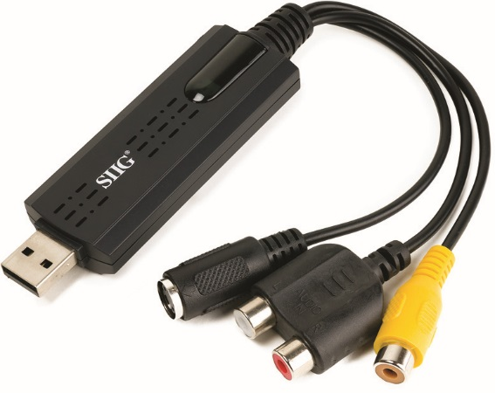
Video Capture
Figure 11.50 A video capture device

Slide 30
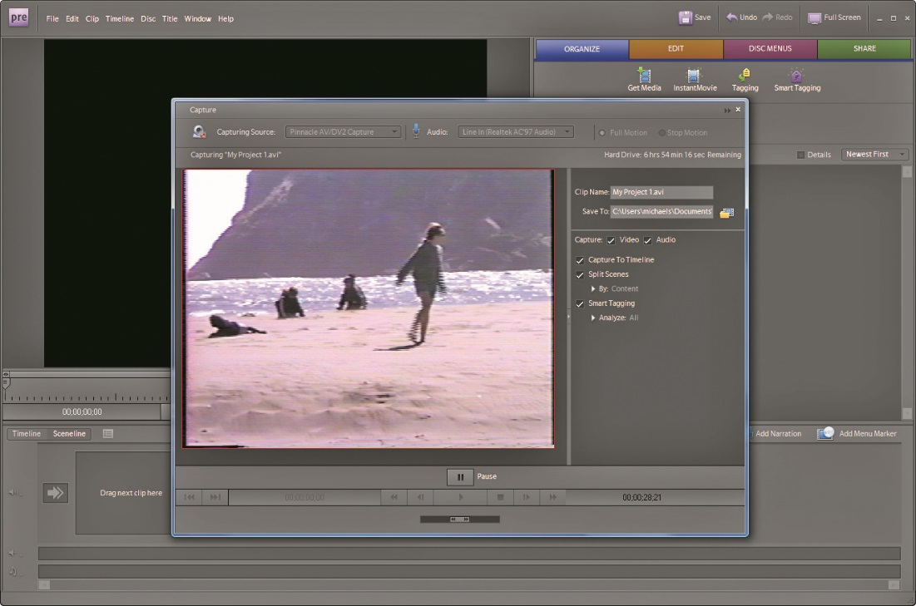
Video Capture
Figure 11.51 Importing video in Adobe Premier Elements

Slide 31
Video Capture
Codecs
Standard audio codecs for audio tracks
Standard video codecs include:
MPEG-2 Part 2 (DVDs)
MPEG-4 Part 2 (Internet broadcasts)
H.264 (Blu-ray Discs)
Windows Media Video or WMV (developed by Microsoft)
Theora (open source)
TrueMotion VP6 (Adobe Flash); VP7 (Skype)
VC-1 (competes with H.264)

Slide 32
Video Capture
Wrappers
A wrapper is a container file.
Both the video and audio streams of a video file are compressed.
Standard video wrappers:
ASF (for WMA and WMV streams)
AVI (standard for Windows)
FLV (flash video)
MOV (standard for Apple Quick Time)
MPEG-2 Transport Stream or MPEG-TS (broadcasting)
Ogg (open source Vorbis and Theora)

Slide 33
TV Tuners
TV tuner allows you to watch HDTV on your computer.
Tuner hardware is available in various options.
Expansion cards that plug into PCI or PCIe slots on the motherboard; PC Card or Express Card; Hi-Speed or Super-Speed USB
Tuner software includes:
Windows Media Center or third-party applications
Online TV channel listings are available through various Internet sites.

Slide 34
Smart TV and Set-Top Boxes
Devices that function as computing devices
Enable viewer to watch content streamed over the Internet
Smart TV
TV with network capabilities
Set-top box
Device to use with a dumb TV
Box handles Internet connectivity and interface

Slide 35
Storage Devices
Removable media: any type of mass storage device that you may use in one system and then physically remove from that system and use in another
Flash memory
USB drives to flash memory cards
Optical discs
Shiny disc technology

Slide 36
Flash Memory
Same type of memory used in CMOS
USB thumb drives
Contain a standard USB connection
Used as storage devices
Notes:
36

Slide 37
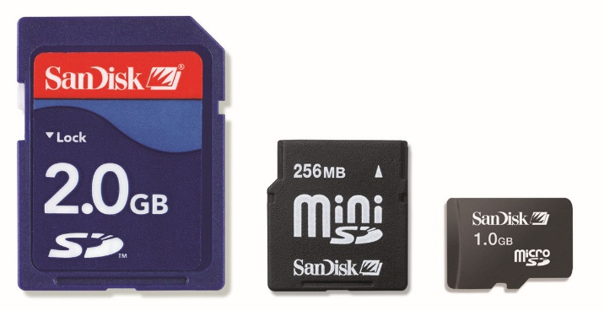
Flash Cards
Data storage on small appliances
Compact flash (CF)
Interconnection via a simplified PCMCIA bus
SmartMedia – replaced by SD media
Secure Digital (SD) cards
Most popular flash media
Smaller forms:
Mini Secure Digital (miniSD)
Micro Secure Digital (microSD)
Figure 11.62 SD, miniSD, and microSD cards

Slide 38
Flash Cards
Memory stick
Sony proprietary format
Extreme Digital (xD) Picture Card
Olympus proprietary format
Used almost exclusively in Olympus and Fujifilm digital cameras
Card reader
Provides ability to read the different types of memory cards
Available separately or built into a PC

Slide 39
Optical Drives
Generically called optical discs
CD (compact disc)
Digital versatile disc (DVD)
Blu-ray Disc (BD)
Various technologies
CD-ROM, CD-R, CD-RW, DVD, DVD+RW, HD-DVD, BD, BD-R, BD-RE
Notes:
39

Slide 40
CD-Media
Data stored in microscopic pits
CD formats
CD Digital Audio (CDDA) – music applications
CD-ROM – CD divided into fixed sectors, each holding 2353 bytes
ISO-9660 filesystem – also called CD File System (CDFS)
CD-ROM speeds
Process data at multiples of 150 KBps
Notes:
40

Slide 41
CD-Media
CD-recordable (CD-R)
Allows users to record data
Available in two sizes:
74-minute 650 MB
80-minute 700 MB
Single-session and multi-session
Single-session allow data to be added only once.
Multi-session enables data to be added multiple times; all modern CD-Rs are multi-session.
CD-R drives have two speeds: write speed and read speed (example: 8×24×).
Notes:
Some music CD players can’t handle CD-R discs.

Slide 42
CD-Media
CD-R drives have been replaced by CD-RW (CD-Rewritable) drives.
CD-RW discs allow data to be written and overwritten .
CD-RW drives have three multiplier values: write, rewrite, read (example: 8×4×32×).
Universal Data Format (UDF) is a CD-media file format.
It is a replacement for ISO-9660.
All movie DVDs use this.
It supports packet-writing features, which enables easy adding and deleting of files on optical media.

Slide 43
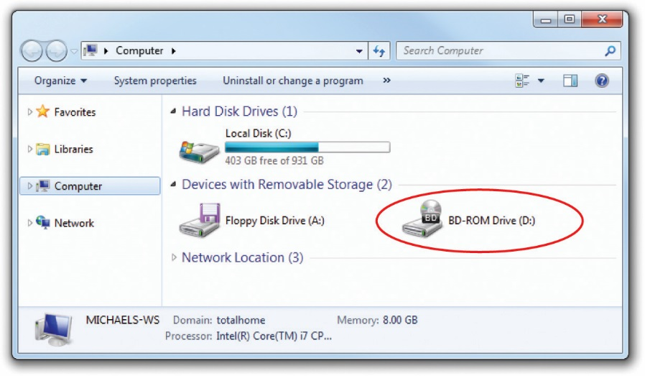
Windows and CD-Media
Virtually all optical drives are ATAPI-compliant.
Plug into ATA controllers on the motherboard
Figure 11.69 Optical drive in Windows
Notes:
43

Slide 44
DVD-Media
Developed by a consortium of electronics and entertainment firms
The DVD was released as digital video discs in 1995.
DVD uses smaller pits than CD-media and packs them more densely, creating much higher data capacities.
DVD comes in both single-sided (SS) and dual-sided (DS) formats.
DVDs also come in single-layer (SL) and dual-layer (DL) formats.

Slide 45
DVD-Media
DVD-Video
Can store two hours of video on one side
Supports TV-style 4:3 aspect-ratio screens as well as 16:9 theater screens
Some producers distribute both on opposite sides of the DVD
Uses MPEG-2 video and audio compression standard
Up to 1280 × 720 at 60 frames per second with CD-quality audio

Slide 46
DVD-Media
DVD-ROM
It is the DVD equivalent of CD-ROM data format.
DVD-ROM stores up to 16 GB of data.
Players support DVD-video and most CD-ROM formats.
Recordable DVD
DVD-R, DVD+R, and DVD+R DL
Cannot erase
DVD-RW and DVD+RW
Can be written and rewritten like CD-RW
Notes:
Apple stopped including optical drives on both desktop and portable systems a long time ago. Instead, Apple offers Remote Disc, the capability to read optical media from an optical drive in another system.

Slide 47
Blu-ray Disc Media
Larger capacity than CD or DVD
25 GB single-layer
50 GB dual-layer
BD-ROM (read only)
Equivalent of DVD-ROM but larger capacity
BD-R (recordable) and BD-RE (rewritable)

Slide 48
Blu-ray Disc Media
Blu-ray Disc burners
These can be connected internally or externally.
Modern Windows and Mac OS X support burners and software.
Most are backwards compatible and will read and play CDs and DVDs.

Slide 49
Blu-ray Disc Media
Blu-ray Disc burners
These can be connected internally or externally.
Modern Windows and Mac OS X support burners and software.
Most are backwards compatible and will read and play CDs and DVDs.
Notes:
Flash media has eclipsed all optical media. Optical media is dying as I write this, and might be dead by the time you’re reading this. Optical media is very important on the 901 exam, though, so memorize the terminology for the exam.

Slide 50
Installing Optical Drives
Optical media drives look similar.
Internal drives use SATA and support ATAPI standard.
External drives use USB or Thunderbolt connections.
Older drives can connect via FireWire or eSATA.
Plug them in and go.

Slide 51
Questions?

Slide 52
Summary
Explain how to support multipurpose connectors
Identify and install standard peripherals on a computer
Identify and install standard storage devices (that aren’t SSDs or HDDs) and their media

Slide 53


